Slide 1
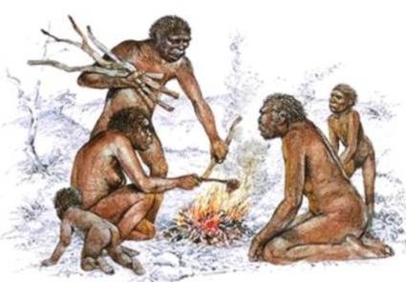
Ch 19 Human Ancestors
Homo habilis
Homo erectus

Slide 2
Intro
H. erectus and H. habilis together known as “early Homo”
1964 – Dr Louis Leakey and team
Found jaw, two cranial fragments and other remains
Olduvai Gorge – east Africa
Dated at 1.75 million years BP
Named “Homo habilis” – “handy man” – tool making
Larger brain and smaller teeth than Australopithecus, different posture
Other skulls found also.
Hard to classify between H. habilis and H. erectus

Slide 3
Early Homo
Walked upright
Hands more robust than modern humans
Powerful grasp suited to climbing trees
Probably spend daylight hours on ground
Gathered food in trees
Slept in the trees for safety
Brain significantly larger than australopithecines
Indicates that diet high in protein, fat and energy
Likely shift to meat as part of diet
Shift in behaviour to hunting
Requires planning and reasoning
Larger brain may have resulted in earlier birth (head too big)
Increased parental care, social cooperation for infants to survive

Slide 4
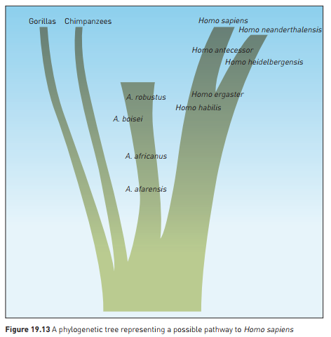
Remember: branching evolutionary pathway, sharing common ancestors!

Slide 5
Homo erectus
First fossils discovered in late 1800s – “Java Man” - Dubois
1927: “Peking Man” – H. erectus – Dr Davidson Black
Found in limestone cave south of Beijing
Brain larger, more modern features
Dental arcade shorter and rounded
Chin beginning to form, short, rounded jaw
Teeth very similar to modern humans – similar diet
Stone tools and hearth also found
Age 500 000 years ago – more recent than Java Man
Footprints found in 2009
At Ileret in Kenya
1.5 million years old
Human-like foot anatomy – big toe parallel, toes short, foot arch
Homo ergaster (often reclassified as African Homo erectus)

Slide 6
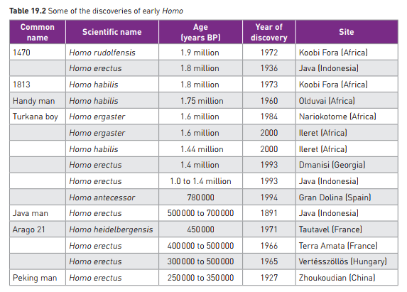

Slide 7
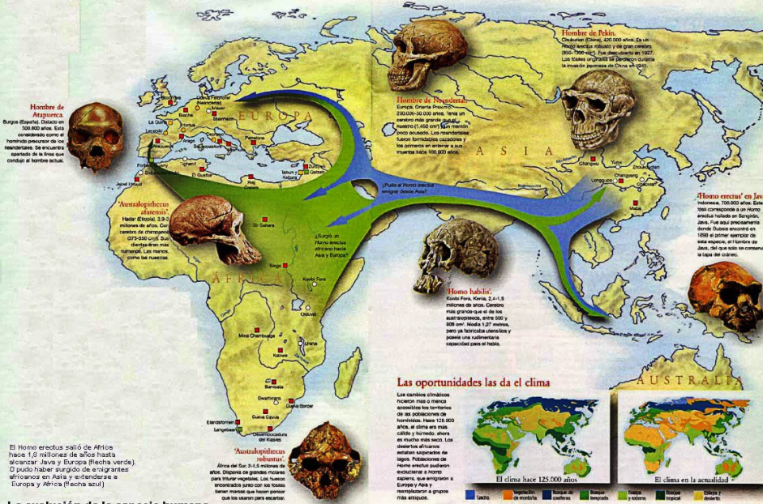

Slide 8
